Slide 1

RETAILNOVA
End-to-End Retail Performance & Behavioral Analytics
- Empowering Growth Through Data-Driven Retention and Profitability
Sara Mahesh | Data Analyst

Slide 2
Project Goals & Cumulative Business Impact
Identify Sales Trends & Anomalies
Customer Behavioural Segmentation
Optimize Product & Inventory
Evaluate Store & Regional Performance
Improve Operational Profitability

Slide 3
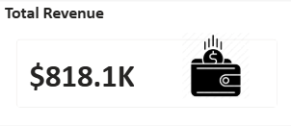
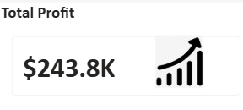
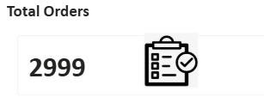
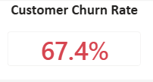
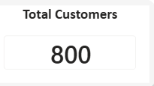
Business Health: Comprehensive Performance Metrics

Slide 4
Technical Workflow & Data Pipeline
Phase 1: Python (Cleaning & Engineering): Handled 800+ customers and 3,000 orders. Fixed leap-year date errors and imputed missing ages by gender-median.
Phase 2: SQL Server (Analysis): Migrated cleaned data to a relational DB. Executed complex queries (Joins, CTEs, Window Functions) to identify the $516K annual revenue vs. total sales.
Phase 3: Power BI (Visualization): Created a Star Schema model with DAX measures for Churn Rate and 90-Day Activity.

Slide 5
Business Intelligence: The SQL Interrogation
Top Performers: Identified BrandC House (40 units) and BrandA Feel (33 units) as high-turnover traffic drivers.
Operational Risk: Used SQL to pinpoint that Home & Kitchen have the highest return rate (5.2%), identifying specific "Profit Killers."
Customer Value: Verified that top-tier customers like Kathy and Christopher contribute significantly more to net profit through long-term loyalty.

Slide 6
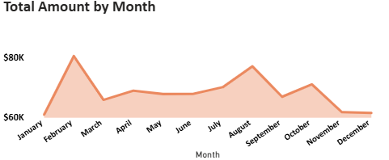
Sales Performance & Anomalies
Revenue Snapshot: Total Lifetime Revenue of $818.1K vs. Last 12 Months of $516.5K.
Trend Analysis: Sales peaks identified in February; identified a trend where Online Sales are growing 12% faster than physical store sales.
The Anomaly: Identified that while revenue is high, profit is being leaked through a 67% churn rate in new sign-ups.

Slide 7
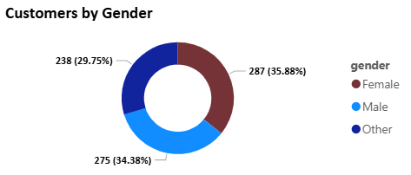
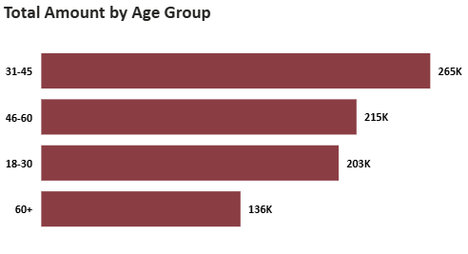
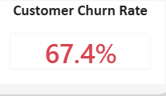
Customer Segmentation & BehavioUral Churn
Churn Reality: The 67.4% churn rate is high, but the data reveals that many "churned" users are new sign-ups who never reached their first purchase.
Demographic Split: Females represent the largest customer segment, while the 31-45 age group (identified in SQL/Python) provides the highest average transaction value.
Loyalty: A small "Gold" tier of loyalists contributes a disproportionate amount of total profit.

Slide 8



Customer Segmentation & BehavioUral Churn
Churn Reality: The 67.4% churn rate is high, but the data reveals that many "churned" users are new sign-ups who never reached their first purchase.
Demographic Split: Females represent the largest customer segment, while the 31-45 age group (identified in SQL/Python) provides the highest average transaction value.
Loyalty: A small "Gold" tier of loyalists contributes a disproportionate amount of total profit.

Slide 9
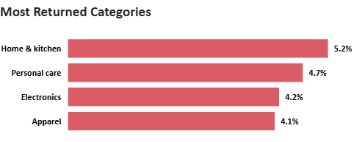
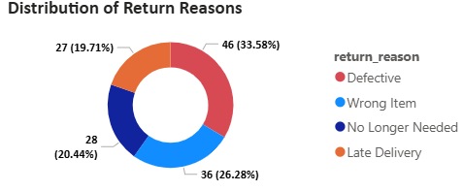
Product Risk & Return Impact
Key Findings:
Financial Leakage: Returns have resulted in a $30.4K loss in potential revenue.
Category Risk: Home & Kitchen see a 5.2% return rate, significantly higher than Apparel.
The "Why": Over 50% of returns are labeled as "Defective" or "Wrong Item," pointing to warehouse or supplier quality issues rather than customer change-of-mind.

Slide 10
Financial Impact & Risk Mitigation
Revenue Protection: Identified a $516K annual revenue stream that requires stabilized retention strategies to maintain.
Cost Recovery: Pinpointed $30.4K in return losses; addressing the "Defective" and "Wrong Item" categories offers an immediate path to recovering lost margins.
Channel Efficiency: Documented a 12% higher profit margin in Online vs. In-Store sales, providing a clear roadmap for high-margin budget allocation.
High-Value Retention: Identified top-tier loyalists (like Kathy and Christopher) who contribute 4x more profit than the average customer, highlighting the financial importance of VIP retention.

Slide 11
Strategic Recommendations
Reduce "Zero-Purchase" Churn: Launch a "Welcome" email automation with a 15% discount code for new sign-ups to convert the 67% churn segment into active buyers.
Retention Program: Create a "VIP Tier" for top contributors like Kathy and Christopher, offering early access to new product launches to maximize Customer Lifetime Value (CLV).
Regional Expansion: Prioritize the South and East regions for the next physical flagship stores, while expanding the Online platform to leverage its 12% higher profit margin.
Quality Control Audit: Immediately audit the supply chain for Home & Kitchen brands identified in the SQL ranking with 5.2%+ return rates to recover $30K+ in annual leakage.

Slide 12
Conclusion
This project has moved the business from "Reactive" to "Proactive" by centralizing fragmented data into a single source of truth.
By optimizing our $818K cumulative base and fixing the $30K return leakage, we have created a scalable model for long-term retail success.
Contact Info: Sara Mahesh | Data Analyst
Email: saramahesh01@gmail.com
LinkedIn: [Your Profile Link]

